Slide 1



INDEPENDENT ADVICE:
UNLOCKING VALUE AND IMPACT IN
A COMPLEX ENVIRONMENT
ANNUAL GENERAL MEETING
#AdviceNIAGM2024
#AccessForAll
@AdviceNI

Slide 2

Welcome and Introduction
Gerard O’Neill
Acting Chair
#AdviceNIAGM2024
#AccessForAll
@AdviceNI

Slide 3
Agenda
Opening & Welcome by Chair
AGM Business
Annual Report
Comfort Break
Guest Speakers
Panel Discussion
Closing Remarks
#AdviceNIAGM2024
#AccessForAll
@AdviceNI

Slide 4

AGM Business
Minutes of Previous Meeting
Matters Arising
Election of Trustees
Treasurer’s Report
#AdviceNIAGM2024
#AccessForAll
@AdviceNI

Slide 5
Election of Trustees
Mathilda Taulbutt – Causeway Women’s Aid
Joanne Farrell – Belfast Unemployed Resource Centre
Barry McMullan – NIACRO
Gerard O’Neill – Springfield Charitable Association Ltd
Michele Loughran – Mindwise
Aisling Cunningham – Housing Rights
Gerard Morgan – East Belfast Independent Advice Centre
Derek McGregor – Community Advice Ards and North Down
Sinead McKinley – South Tyrone Empowerment Programme
#AdviceNIAGM2024
#AccessForAll
@AdviceNI

Slide 6
Treasurer’s
Report
Paul Dolan
Finegan Gibson Chartered Accountants
#AdviceNIAGM2024
#AccessForAll
@AdviceNI

Slide 7
Annual Report
Bob Stronge, CEO
Advice NI
#AdviceNIAGM2024
#AccessForAll
@AdviceNI

Slide 8
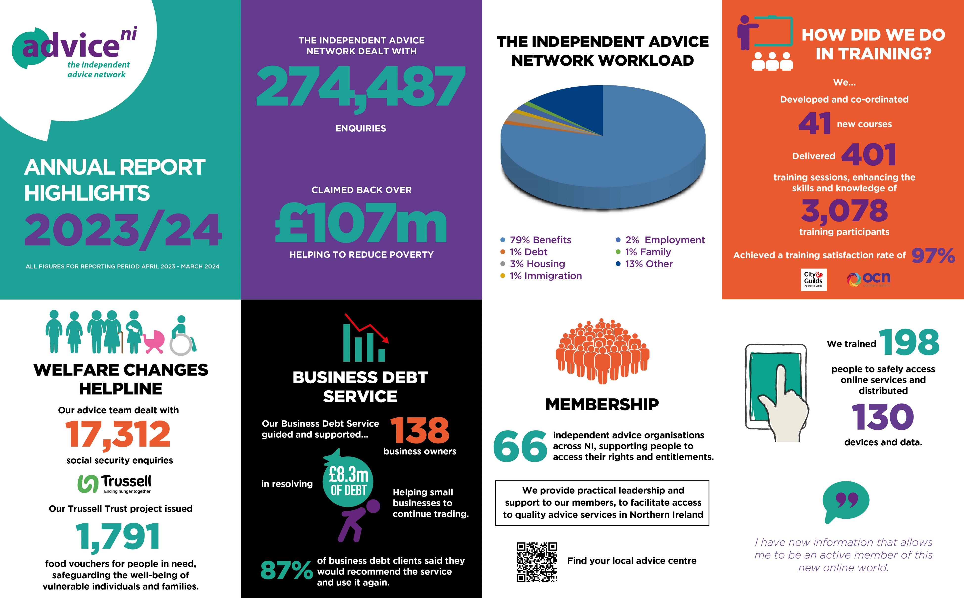

Slide 9
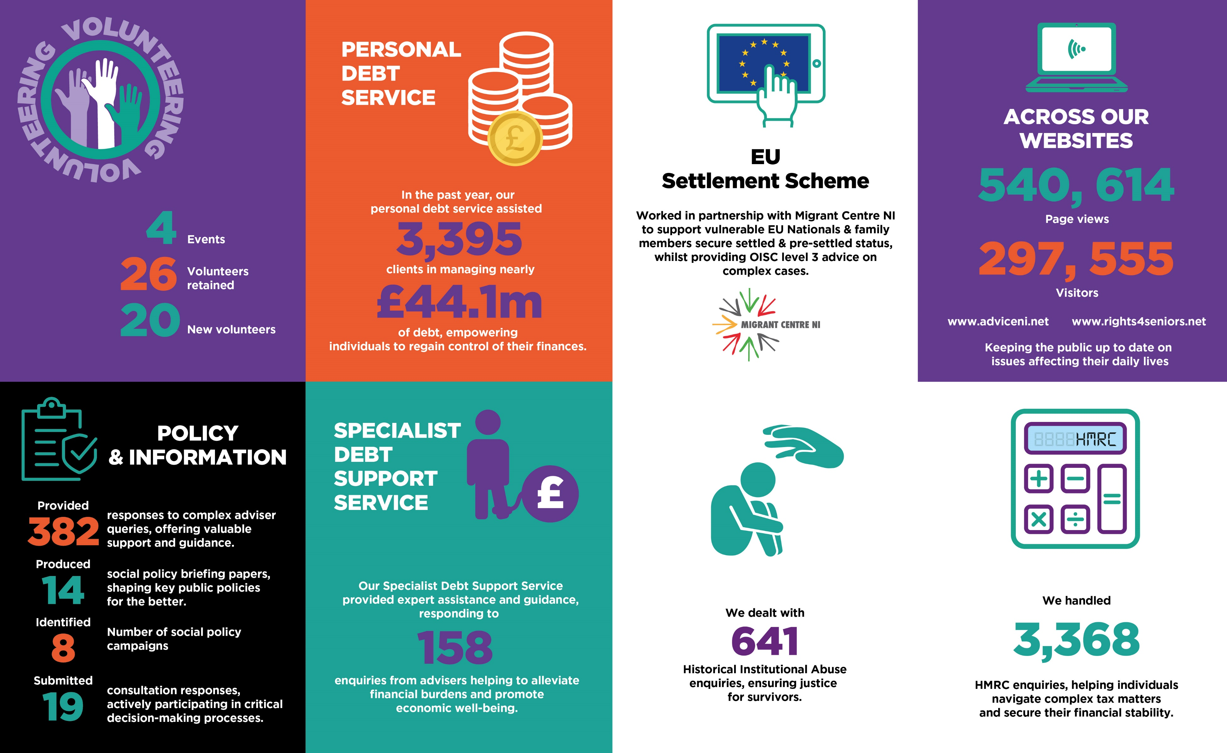

Slide 10
Comfort break
Resume in 10 minutes
#AdviceNIAGM2024
#AccessForAll
@AdviceNI

Slide 11
Independent Advice: Unlocking Value and Impact in a Complex Environment
David Tarr
Department for Communities
Welfare Mitigation Schemes Statutory Report update
#AdviceNIAGM2024
#AccessForAll
@AdviceNI

Slide 12

Social Security Policy, Legislation and Decision-Making Services
Advice NI Annual General Meeting
Thursday 30 January 2025
David Tarr and Jennifer Gibb

Slide 13

Advice NI AGM
Statutory Report
The Welfare Supplementary Payments (Amendment) Act (Northern Ireland) 2022 introduced a statutory requirement on the Department for Communities to produce a report setting out the Department’s assessment of the operation of each of the ongoing Welfare Supplementary Payment (WSP) schemes by 31 March 2025.
To provide a comprehensive review of the full mitigations package the report provided an update on the Universal Credit Contingency Fund, the work of the Independent Advice Sector and the performance of Social Supermarkets.
This report was laid before the Assembly in December 2024 and published on the Department’s website on 9 January 2025.
NI & ROI Policy Exchange

Slide 14

Advice NI AGM
Statutory Report
NI & ROI Policy Exchange
The report gathered the following information:
The amount of financial support paid and the number of people receiving support from each of the schemes.
The cost to administer the schemes in terms of staffing and IT infrastructure.
The operational challenges arising from the delivery of the schemes as the number of people on to Universal Credit increases.
External engagement seeking views through an online survey and a meeting with key stakeholders.

Slide 15

Advice NI AGM
Statutory Report
The information gathered for the report led to the following proposals being brought forward:
To introduce legislation to extend those WSP schemes that were due to end on 31 March 2025 to 31 March 2028.
To introduce legislation to ensure that WSP mitigation continues as it currently is for both the Benefit Cap and the Social Sector Size Criteria, without the re-introduction of scenarios when exclusions to mitigation may result.
NI & ROI Policy Exchange

Slide 16
Advice NI AGM
Statutory Report
To introduce legislation to provide a statutory basis for payment of WSP mitigation to those people claiming Universal Credit.
To consider how communications around the WSP schemes could be improved.
To look at how the current operational delivery of the WSP schemes could be enhanced considering both IT and manual solutions.
NI & ROI Policy Exchange

Slide 17

Advice NI AGM
Statutory Report
NI & ROI Policy Exchange
The report also acknowledged the need to preserve the existing capacity in the advice sector to meet the continuing demand for independent advice. Therefore, the report also contained proposals to:
Continue to support Social Supermarkets in recognition of the pressure on household budgets due to the increased cost of living.
Continue to fund advice services at existing levels. Consideration will be given to including advice funding, which is currently provided via the welfare mitigations package, within the Department’s budget allocation to preserve capacity in the advice sector.

Slide 18
Advice NI AGM
Next Steps
NI & ROI Policy Exchange
Executive agreed the Statutory Report on 5 December 2024.
Legislation to extend the mitigation payments currently being drafted.
Communications planned to advise customers about their mitigation payments.

Slide 19
Advice NI AGM
Welfare Mitigations Legislation Timeline
NI & ROI Policy Exchange
The Welfare Supplementary Payment (Extension) Regulations (Northern Ireland) 2025
The Universal Credit (Welfare Supplementary Payment ) Regulations (Northern Ireland) 2025
The Universal Credit (Welfare Supplementary Payment) (Social Sector Size Criteria) Regulations (Northern Ireland) 2025
January 2025
SL1’s issued to the Communities Committee
February 2025
Regulations laid in Draft
March 2025
Regulations Debated in Assembly
March 2025
Regulations come into operation on the day after the day they are made

Slide 20
Independent Advice: Unlocking Value and Impact in a Complex Environment
Clare Carter
Access to Justice Foundation
The Value of Legal Advice Services
#AdviceNIAGM2024
#AccessForAll
@AdviceNI

Slide 21

The value of legal advice services
Clare Carter, CEO

Slide 22





About us
Funding free legal advice where it's most needed
Our vision is a society where everyone has access to justice.
Our mission is to improve people’s lives by increasing the availability of quality legal advice and support.
The Access to Justice Foundation
Increasing available funds
Effective grant making
Making the case

Slide 23
Increasing resources for free legal advice across the UK
Established under s194 Legal Services Act by the legal profession
Pro Bono Costs Orders/ Collective actions
Exploring new funding models
Fundraising with the legal community, philanthropic sector and governments

Slide 24
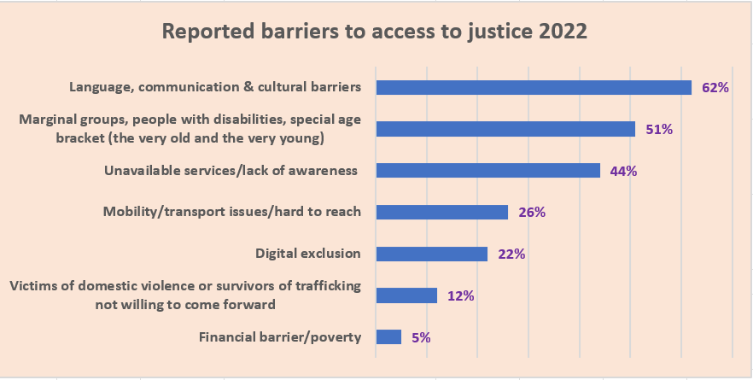
Impacts and barriers
How advice helps
Issues at play
Keeps families in their homes
Keeps women and children safe from domestic abuse
Helps people to rebuild their lives after fleeing war and persecution
Helps disabled people access the support they need to live independently
Challenges unfair and discriminatory behaviours
Helps older people access the income they are entitled to so they can eat and stay warm

Slide 25



The Difference you make
“Your service is vital for people like me. The service is a lifeline for the community. I think this service is here for me. Maybe it was created to save me. Without it, I do not know how I would have managed.”
– Edith
“I was so much more confident going into court representing myself this time around, I actually spoke and stated all my concerns…I can't thank you enough for all your help and advice in that short period of time! You were simply amazing.”
– Gary
“Thank you so much for holding me up during this process…I deeply appreciate your help.”
– Aurelia

Slide 26
Complexities and ecosystems
Short term project funding
Chronic underfunding and lack of funder collaboration
Shift to digital by default
Range of providers
Recognising advice need
Needs of particular communities

Slide 27
The case for free legal advice
Individuals and families accessing specialist advice services frequently present with multiples legal problems, with an average of 4.86 issues per person seeking advice.
· In 2022/23, Civil Legal Aid provision was £728 million lower in real terms than it was a decade ago. Respondents reported just 8% of their funding for free legal advice provision came from Legal Aid.

Slide 28
Economic impact
o Research showed average savings of £9,100 per case or ~£4.5bn for every 500k people
o For each person who receives advice, 0.39 additional household members become employable. Advising 100,000 clients could lead to 38,900 more people entering the workforce, generating approximately £81 million in income tax and National Insurance contributions.
o People with access to free specialist legal advice are projected to spend 1.6 fewer years in crisis compared to those without access.
o Advising 100,000 clients could lead to 38,900 more people entering the workforce, generating approximately £81 million in income tax and National Insurance contributions

Slide 29
Justice for all?
Key statistics
· Demographic of free legal advice clients in 2023:
o 51% of people seeking advice have a long-standing illness or disability.
o 12% were homeowners.
o 70% were private or social renters.
o 37% were employed or self-employed.

Slide 30
Thank you!
For more information contact me:- clarecarter@atjf.org.uk
www.atjf.org.uk

Slide 31
Independent Advice: Unlocking Value and Impact in a Complex Environment
Agnes Fraser
Tar Isteach
Insights from the Frontline
#AdviceNIAGM2024
#AccessForAll
@AdviceNI

Slide 32
Independent Advice: Unlocking Value and Impact in a Complex Environment
Liz Bayram
Advice UK
Advice Saves Lives
#AdviceNIAGM2024
#AccessForAll
@AdviceNI

Slide 33
#AdviceSaves
Liz Bayram
Chief Executive
February 2025
Notes:
Delighted to have been invited to your AGM and to have the opportunity to share some of our recent advocacy work with you all
Also to share our members experiences with you and to hear from you all to
No doubt – despite different legislation, regulation etc – we have many shared experiences and views

Slide 34
Introducing AdviceUK
  We are a small charity that has a big impact.
  Our purpose is to improve the lives of people in need of advice.
  We do this by supporting our members, so it is easier for them to help their clients, and by directly influencing policy-makers, decision-makers and funders.

Slide 35
Challenges
  Sustaining advice that is free, independent and high quality
  Making advice part of bigger journeys that empower and enable individuals and communities
  Resources available to civil society under great pressure – danger that we lose connection to communities
  Workforce challenges - recruiting, retaining experienced advisers; supporting staff dealing with complex and stressful client cases
  Social security, housing, legal systems often fail to improve people’s lives in the medium to longer-term

Slide 36
Opportunities
  Sharing evidence and data of what works with decision-makers, policy makers and funders
  Providing solutions as well as raising concerns
  Embracing technology – to grow capacity or to improve quality of interactions with clients
  Staying connected with each other to share ideas, resources and with organisations who share our concerns and can help us ensure change.
  Redefining how advice is integrated into the services that people use – building on innovation in our sector; on what we know works

Slide 37
#AdviceSaves Findings
The Current Crisis:
90% of advice centers report increased demand.
Over half (55%) lack confidence they can meet this demand.
Nearly two-thirds (61%) expect to reduce or cut services due to funding challenges.
Only 1 in 10 centers feel financially sustainable for the next year.
Why Advice Matters:
A lifeline for vulnerable populations.
Prevents problems from escalating into crises.
Reduces pressure on public services like the NHS and local councils.
Call for Urgent Action:
Without sustainable support, the most vulnerable will lose access to life-changing advice services.

Slide 38
#AdviceSaves Policy Asks
  Sustainable Funding Solutions: Expand statutory funding for advice services , building on provisions in the Care Act 2014 and Homelessness Reduction Act 2017.
  Cross-Departmental Strategy: Create a government-wide advice strategy in England and Scotland, modelled on Wales' Information and Advice Action Plan, integrating advice across housing, health, social care, education and justice sectors.
  Workforce Development: Introduce apprenticeships and career pathways to support recruitment and retention.

Slide 39
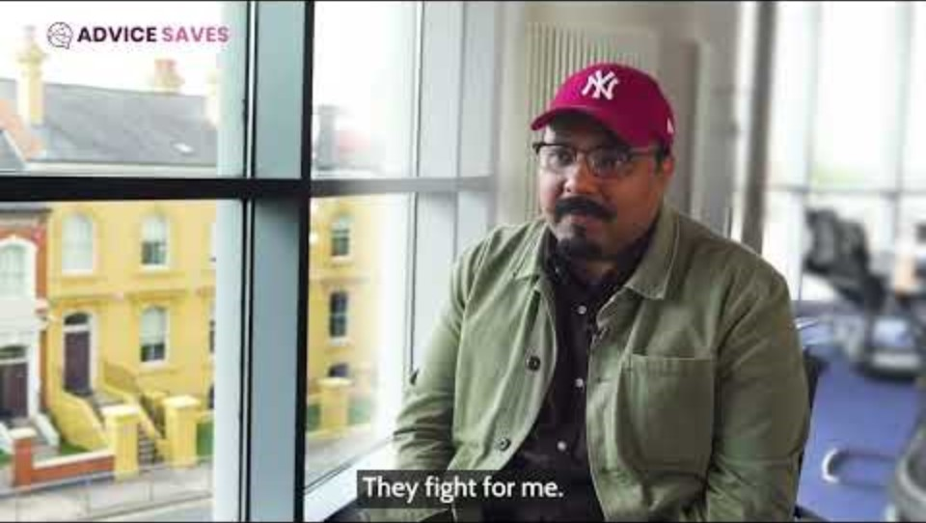
#AdviceSaves Policy Asks

Slide 40
Launch of Advice NI draft strategic plan
Fiona Magee
Advice NI
Strategic Plan for Consultation
#AdviceNIAGM2024
#AccessForAll
@AdviceNI

Slide 41


Slide 42

Advice NI Strategic Focus Areas 2021-2024
Strengthening and Supporting the Network
Meeting Client Need
Ensuring the Organisation is Fit for Purpose

Slide 43
Progress and Impact 2021-2024
Advice
10,000 Information resources published annually
20,000+ callers to our helplines annually
£13m business debt
£33.5m personal debt
120+ Policy Guides
Engagement
100 new Advice Link Users
500 new Advice Matters subscribers
13 channels of engagement
65+ Social Policy Briefing Papers
265+ Specialist Support queries
PR Assistance – 31 with press releases, 25 with PR materials.
310 K+ social media impressions
9k increase in social media followers
30+ consultation responses
Training
1,287 training sessions
10,000 attendees
97% satisfaction rate
121 new training
Digital
31% increase in use of the accessibility tools
400+ people trained to go online safely
20 Volunteer Digital Champions trained
Introduced MSO 365
Quality
6,920 CFR’s
104 assessor workshops,
55 peer review workshops

Slide 44
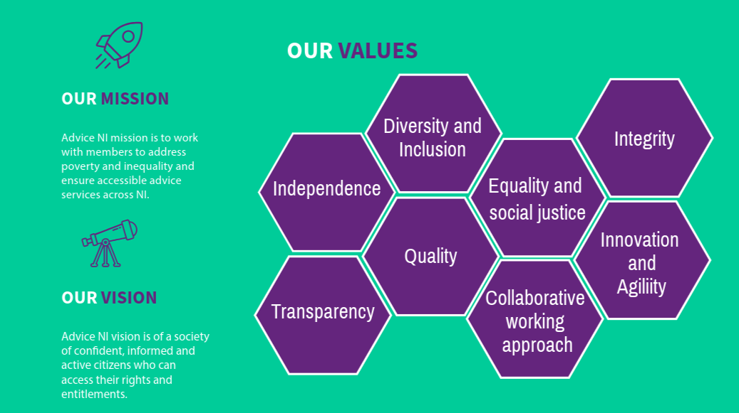

Slide 45
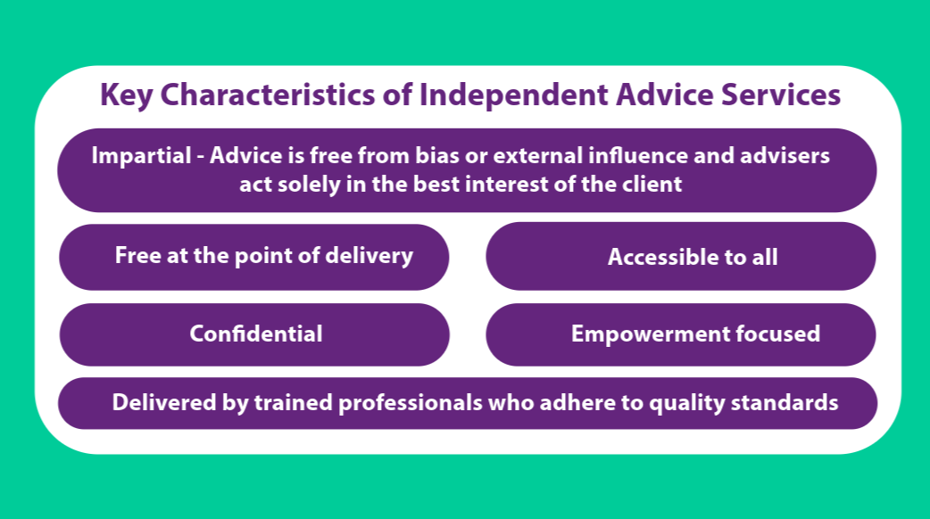

Slide 46
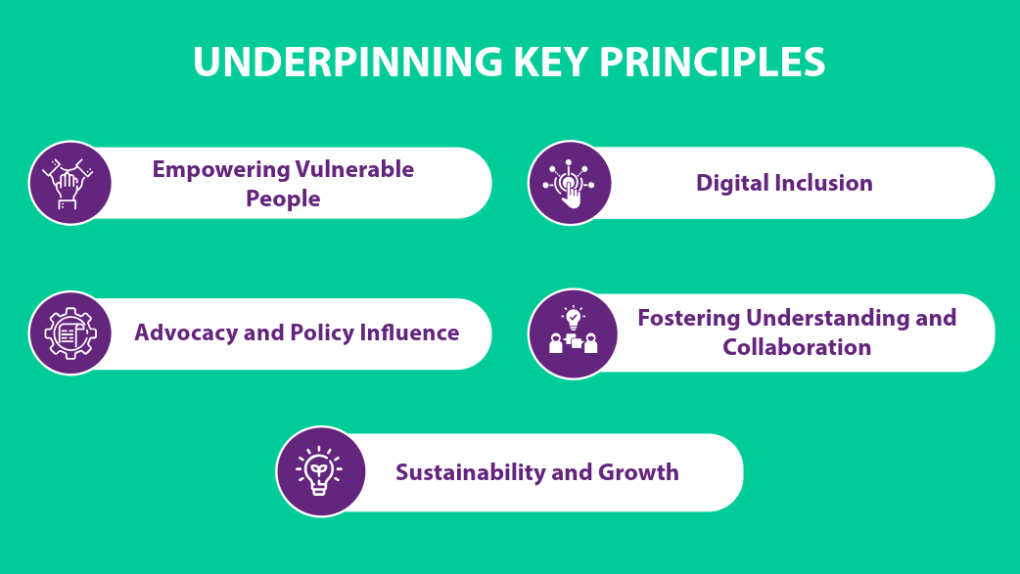

Slide 47
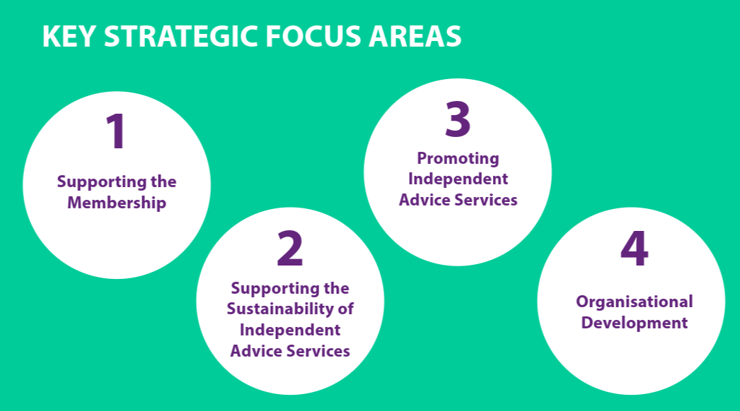

Slide 48
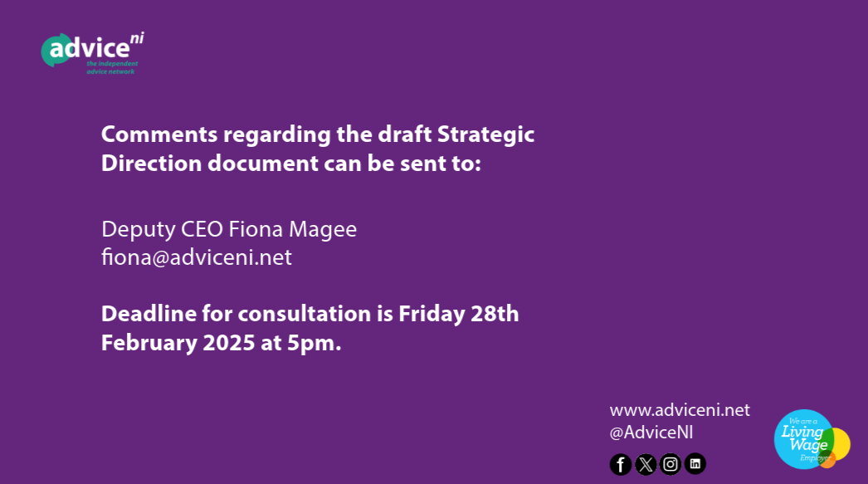

Slide 49
Panel Discussion
Panel Chaired by John Campbell, BBC NI
Economics & Business Editor
David Tarr, Department for Communities
Liz Bayram, Advice UK
Bob Stronge, Advice NI
Clare Carter, Access to Justice Foundation
Agnes Fraser, Tar Isteach
#AdviceNIAGM2024
#AccessForAll
@AdviceNI

Slide 50
Closing remarks
Bob Stronge
CEO
Advice NI
#AdviceNIAGM2024
#AccessForAll
@AdviceNI

Slide 51
Lunch
Lunch is being served in
Conference Rooms 1 & 2
#AdviceNIAGM2024
#AccessForAll
@AdviceNI

